Slide 1

Creative Excellence: Semantic Knowledge Graph Construction
Presenting an end-to-end NLP pipeline for transforming unstructured text into actionable, structured knowledge graphs, deployed interactively via Streamlit.

Slide 2

Project Title & Overview
Project Title
1
Semantic Knowledge Graph Construction and Intelligent Query Answering using NLP Techniques
Core Focus
2
End-to-End NLP Pipeline with Streamlit Deployment
Presented by
SaiTejaswi
Jahnavi Lakshmi
Poobesh Raj
Shivam Kanse

Slide 3
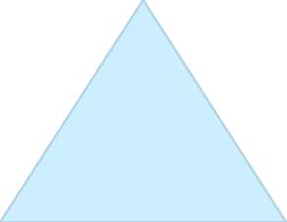
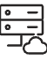

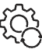



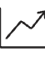




Project Overview: The NLP-to-Knowledge Pipeline
Our primary motivation is to effectively transform vast amounts of unstructured textual data into structured, semantically rich knowledge. This process enables advanced query answering and domain linking, making information retrieval precise and contextual.
Data Collection
Curating factual text corpus.
Preprocessing
Text cleaning and tokenisation.
NER & RE
Extraction of entities and relations (triples).
Semantic Graph
Construction using NetworkX.
Intelligent Query
Semantic search implementation.
Deployment
Interactive Streamlit application.
.

Slide 4
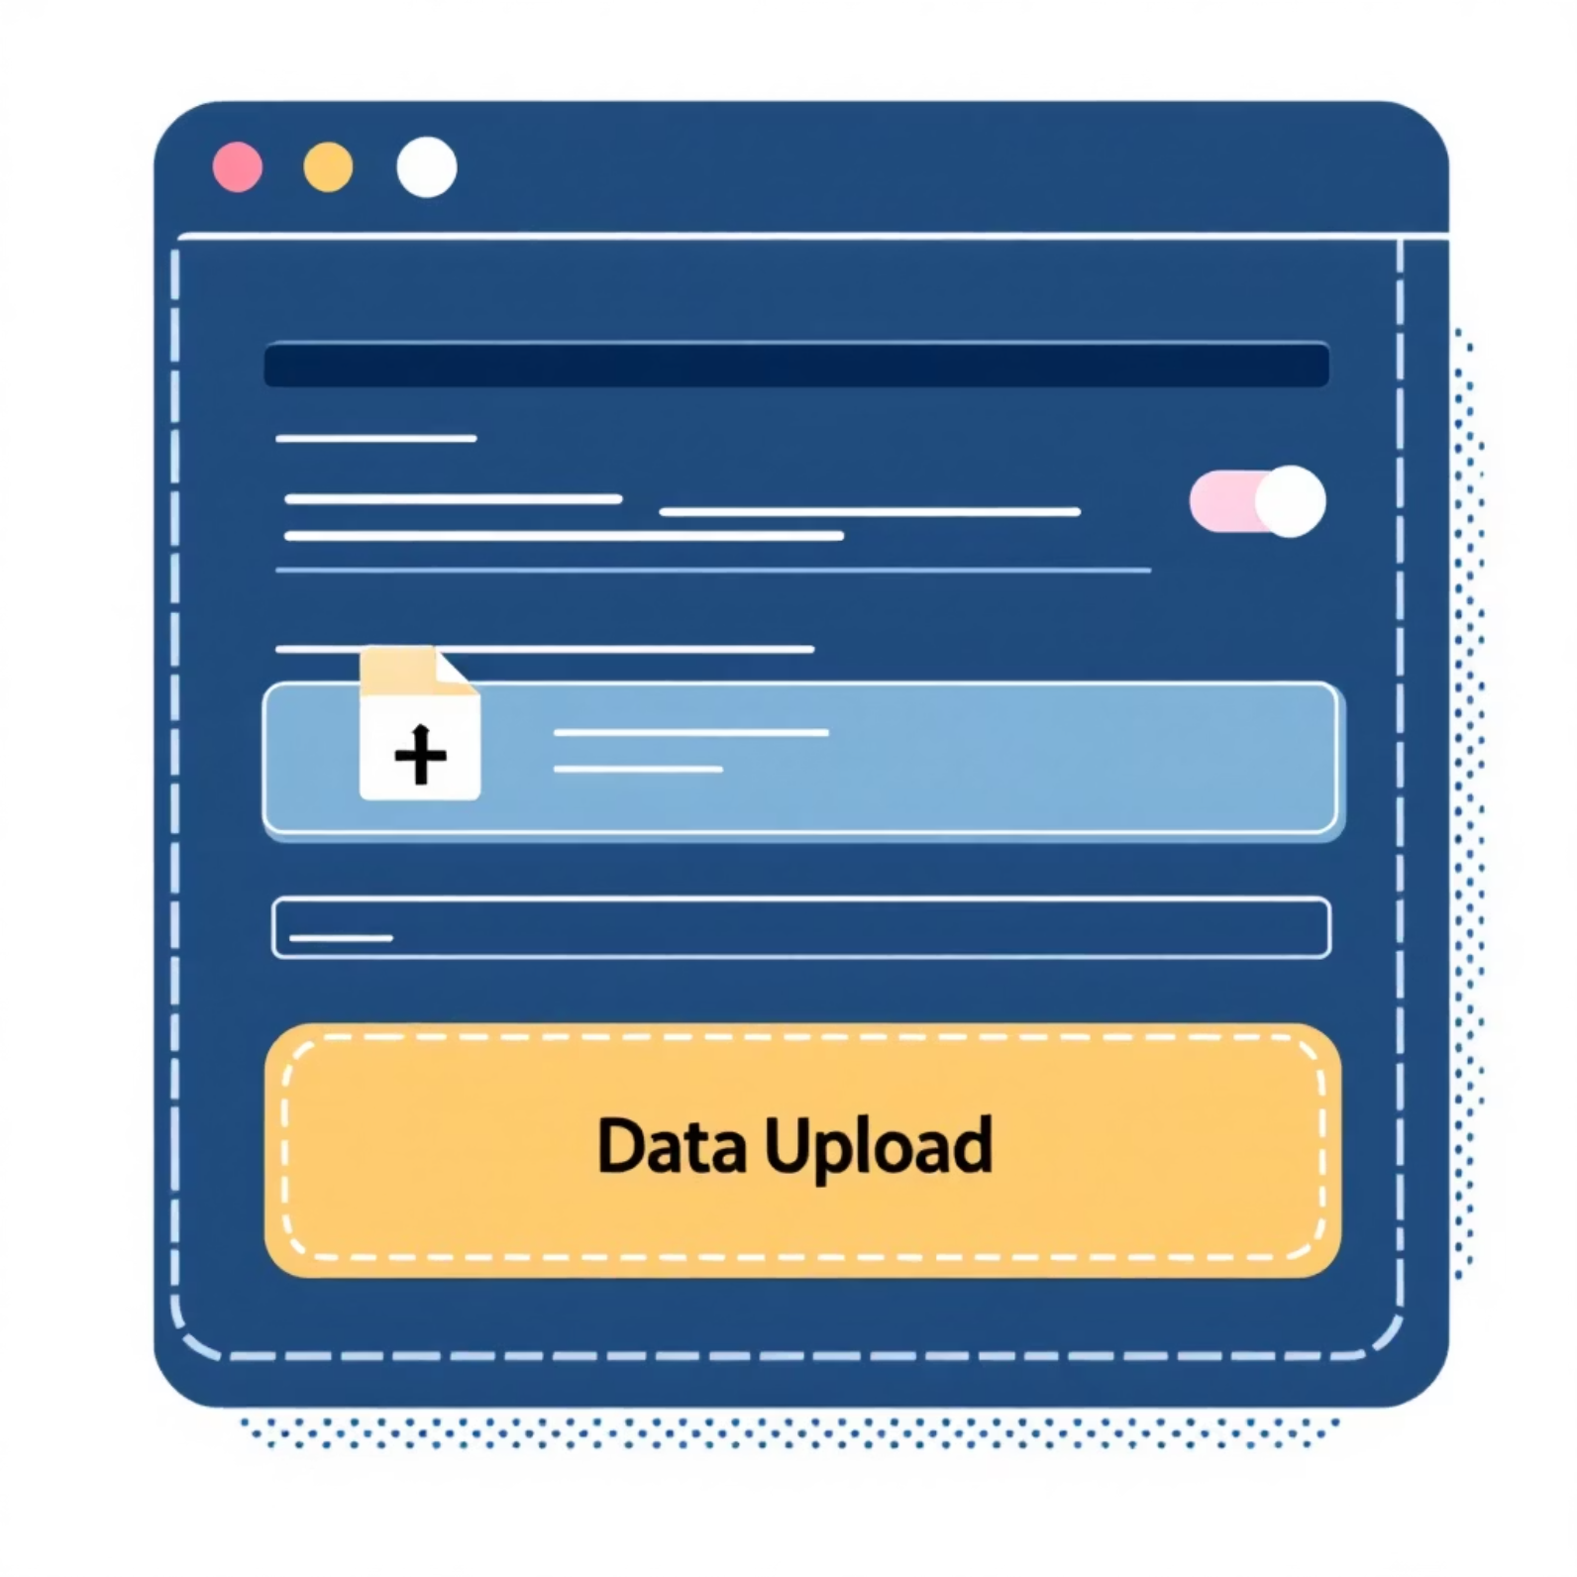
Data Collection
The foundation of our knowledge graph is a carefully curated dataset, ensuring diversity, factual correctness, and
appropriate structure for automated extraction.
This initial structured approach guarantees high-quality input, crucial for training
robust extraction algorithms and maintaining the integrity of the resulting
knowledge graph.
Dataset Specification
Corpus Size: Approximately 200 factual sentences.
Content Focus: Wikipedia-style descriptive statements across multiple
domains (e.g., science, history, geography).
Format: Structured input provided via CSV or Excel sheets to facilitate batch
processing and automated ingestion by the pipeline.
Quality Control: Emphasis on high factual correctness to maintain graph
integrity.
Preview (example)
Sentence 1: Albert Einstein developed the theory of relativity.
Sentence 2: The Amazon River flows across northern South America.
Sentence 3: Apple Inc. released the iPhone X in 2017.
.
.

Slide 5

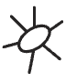


Data Preprocessing — Preparing for NLP
Effective preprocessing is crucial for achieving high accuracy in downstream NLP tasks. This stage transforms raw, noisy text into clean, standardised input ready for entity and relation extraction.
Text Cleaning
Tokenisation
Removal of special characters, unnecessary whitespaces, and normalisation of text casing.
Breaking down cleaned sentences into individual words or sub-word units (tokens).
Part-of-Speech (POS) Tagging
Ready for Extraction
Labelling each token with its grammatical role (noun, verb, adjective), essential for accurate dependency parsing and relation extraction.
The standardised tokens provide the precise context needed for spaCy models.
This standardisation process significantly reduces ambiguity, ensuring that the Named Entity Recognition (NER) and Relation Extraction modules receive optimal input.

Slide 6
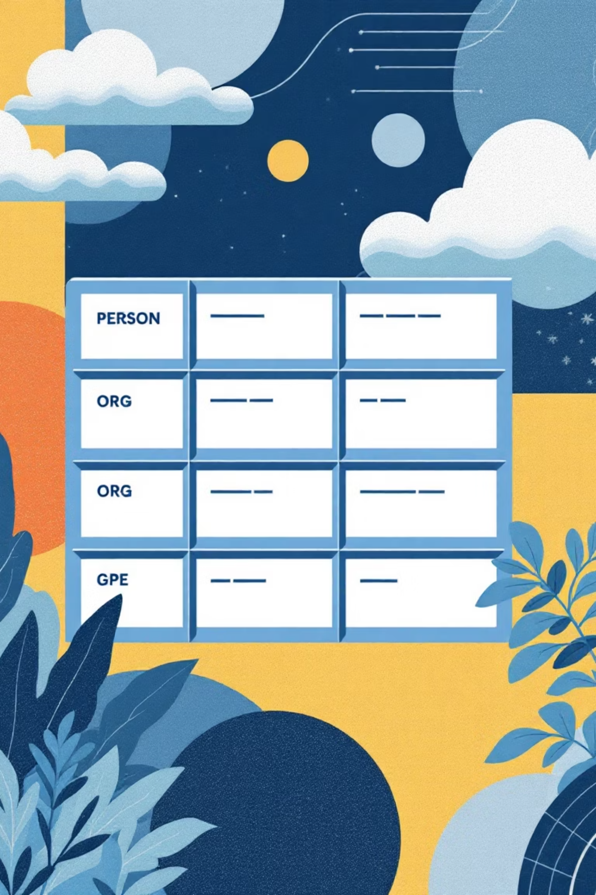



Named Entity Recognition (NER)
NER is the process of identifying and classifying named entities in the text into predefined categories. We leverage the power and robustness of the spaCy library for this critical step.
Entity Identification
Classification
Locating entities such as names, places, organisations, and dates within sentences.
Assigning a type or category to the identified entity (e.g., PERSON, ORG, GPE, WORK).
Technology Stack
Utilising spaCy's pre-trained or custom-trained statistical models for high-precision recognition.
Example: “Albert Einstein [PERSON] developed the theory of relativity [WORK].”
Named entities automatically detected from input sentences, forming the nodes of
our graph.

Slide 7
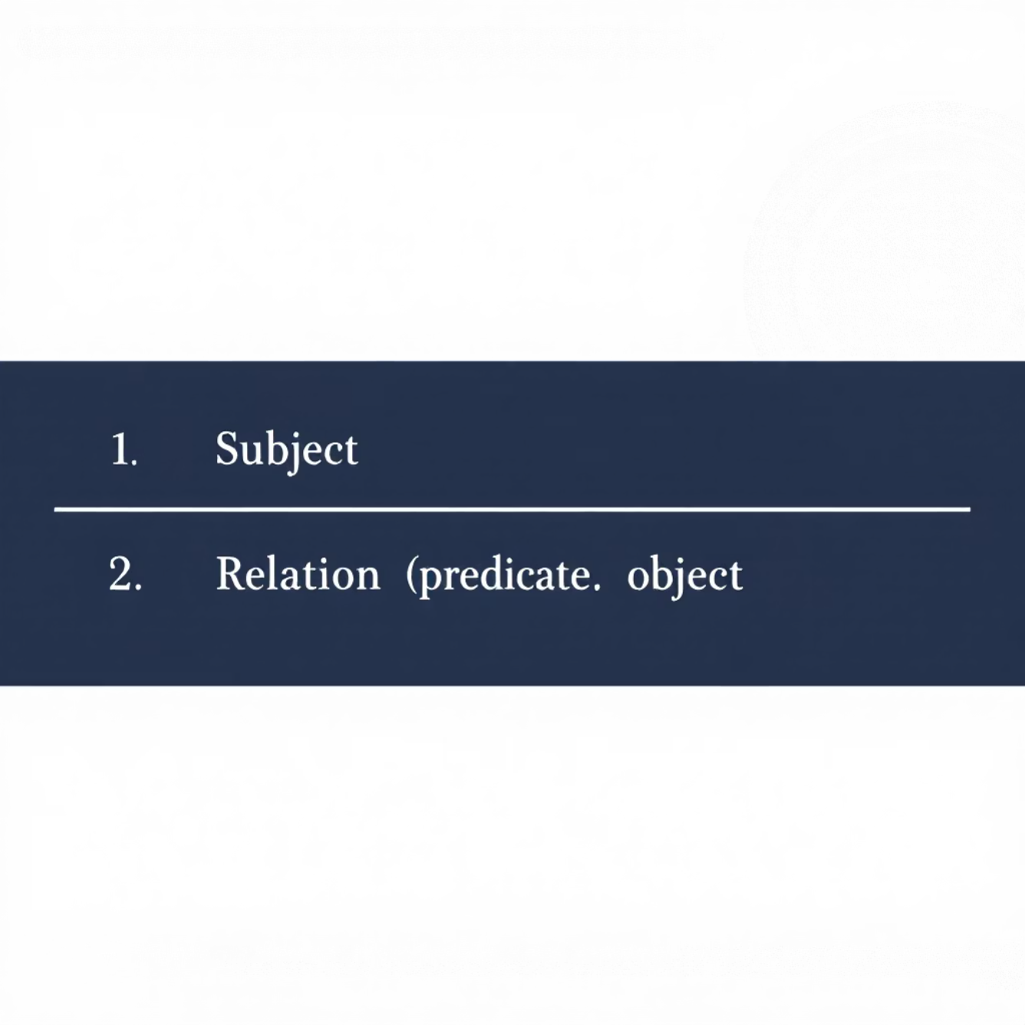
Relation Extraction (RE) – Forming Triples
Relation Extraction establishes the links between the named entities, constructing the fundamental Subject–Relation–Object (S-R-O) triples that define the structure of the knowledge graph.
Methodology: Dependency Parsing
We use dependency parsing to analyse the grammatical relationships between words. The core logic identifies the main verb (ROOT) and then maps its nominal subject (nsubj/nsubjpass) and direct/indirect objects (dobj/attr/oprd).
if token.dep_ == "ROOT" and token.pos_ == "VERB": subj = [w.text for w in token.lefts if w.dep_ in ["nsubj", "nsubjpass"]] obj = [w.text for w in token.rights if w.dep_ in ["dobj", "attr", "oprd"]]
Extracted subject–relation–object triples,
ready for graph instantiation.
The resulting triples—such as (Albert Einstein, developed, theory of relativity)—serve as the edges and nodes of the semantic graph.

Slide 8
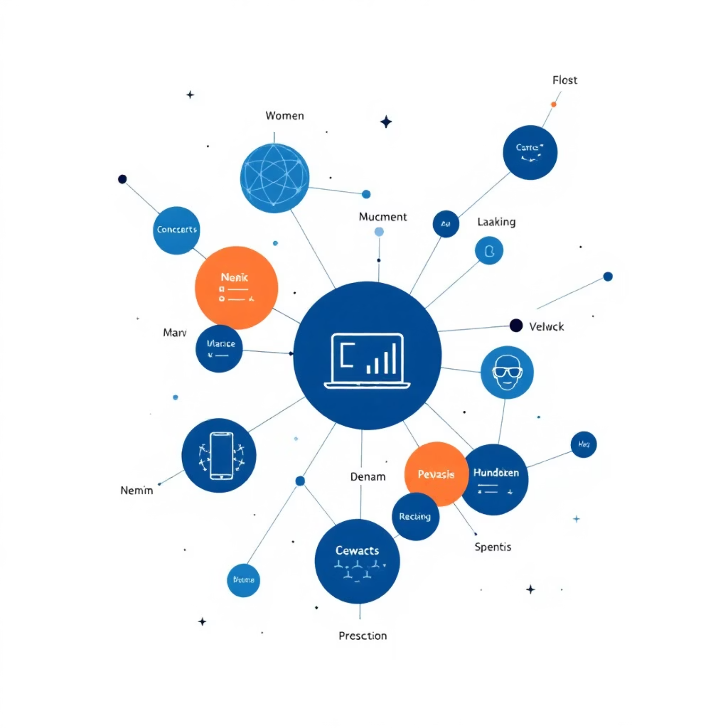
Semantic Graph Construction
Transforming extracted triples into an interactive knowledge network
The extracted Subject-Relation-Object (S-R-O) triples are converted into a directed graph, where entities serve as nodes and relationships become directed edges. These edges are labeled with the relation type and can include optional metadata, such as provenance or contextual information, enriching the graph's semantic depth.
Tools & Frameworks
NetworkX
Utilised for robust graph modeling and structural analysis, providing
a flexible framework for graph manipulation.
PyVis
Employed for real-time interactive graph visualization within
web applications, allowing users to dynamically explore connections.
Data Portability
Graphs are stored in serializable formats like GraphML or JSON-LD for
enhanced portability and reuse across platforms.
Interactive semantic graph showing entities and their relationships.

Slide 9
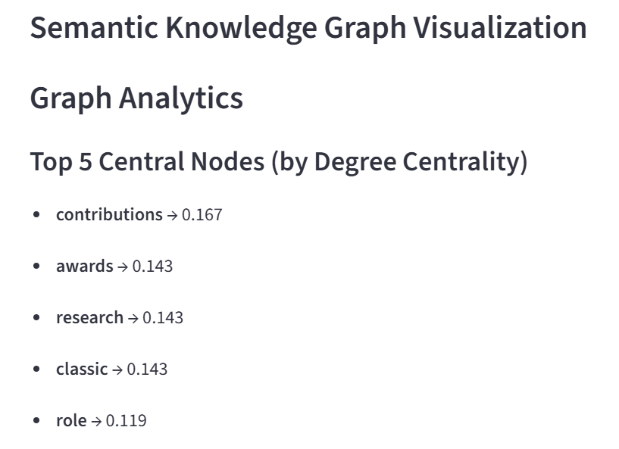
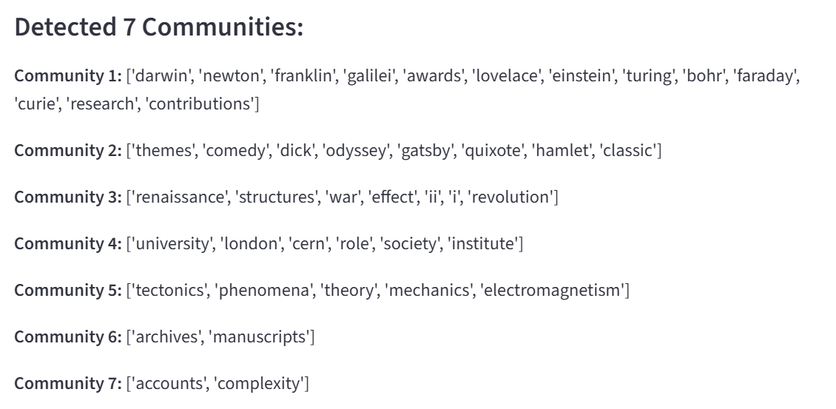
Centrality & Community Detection
Understanding influence and structure within the semantic graph
Centrality Analysis
Community Detection
Degree centrality computed to identify
influential entities and hub nodes.
Modularity-based clustering algorithms (Louvain, Girvan-Newman) uncover topic-based subgraphs.
Betweenness centrality reveals key connectors
bridging different graph regions.
Hierarchical community detection reveals nested organizational structures.
Eigenvector centrality identifies nodes connected
to other important nodes.
7 distinct communities detected in our knowledge graph.
Central Hubs
Community Clusters
Bridging Nodes
Inter-Cluster Links
A visual representation of the knowledge graph, demonstrating identified communities and their interconnections.

Slide 10



Deep Dive: Community Detection
Community Detection is a powerful graph analytic technique that identifies sub-groups or "communities" of closely related entities within the knowledge graph. This helps to uncover hidden thematic structures and relationships.
Algorithmic Foundations
Identifying Communities
Actionable Insights
We primarily employ modularity-based algorithms, such as the Louvain or Leiden method, which are highly efficient in identifying communities by optimising a 'modularity' score across the graph.
These algorithms group nodes (entities) that are more densely connected to each other than they are to nodes in other parts of the graph. This signifies a strong internal relationship within the group.
By revealing these clusters, we can identify latent topics, sub-domains, or even emerging trends within the unstructured data, providing a deeper understanding of the dataset's inherent structure.
For example, in a corpus of scientific papers, community detection might reveal distinct research areas or collaborations among authors.

Slide 11

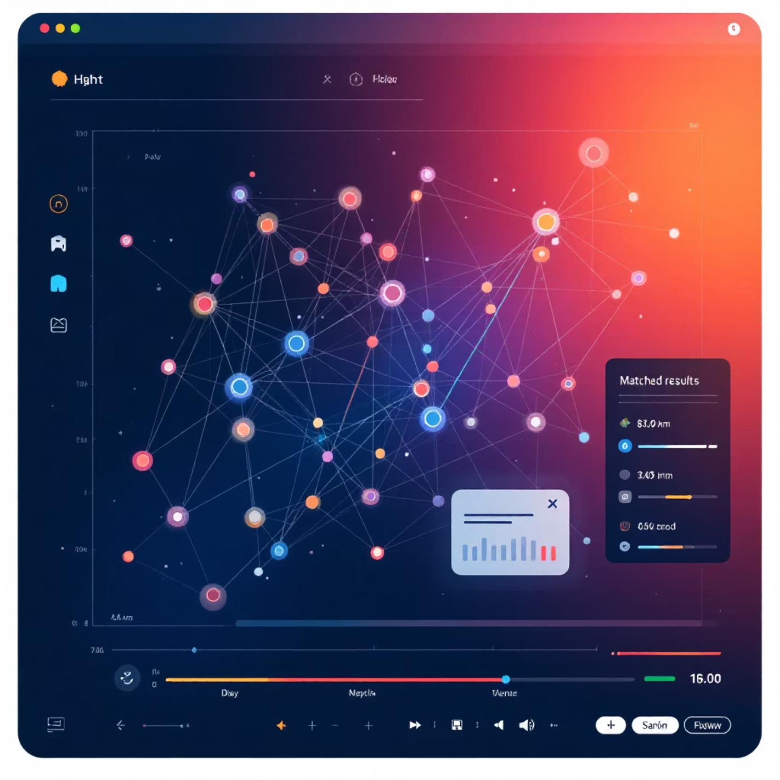
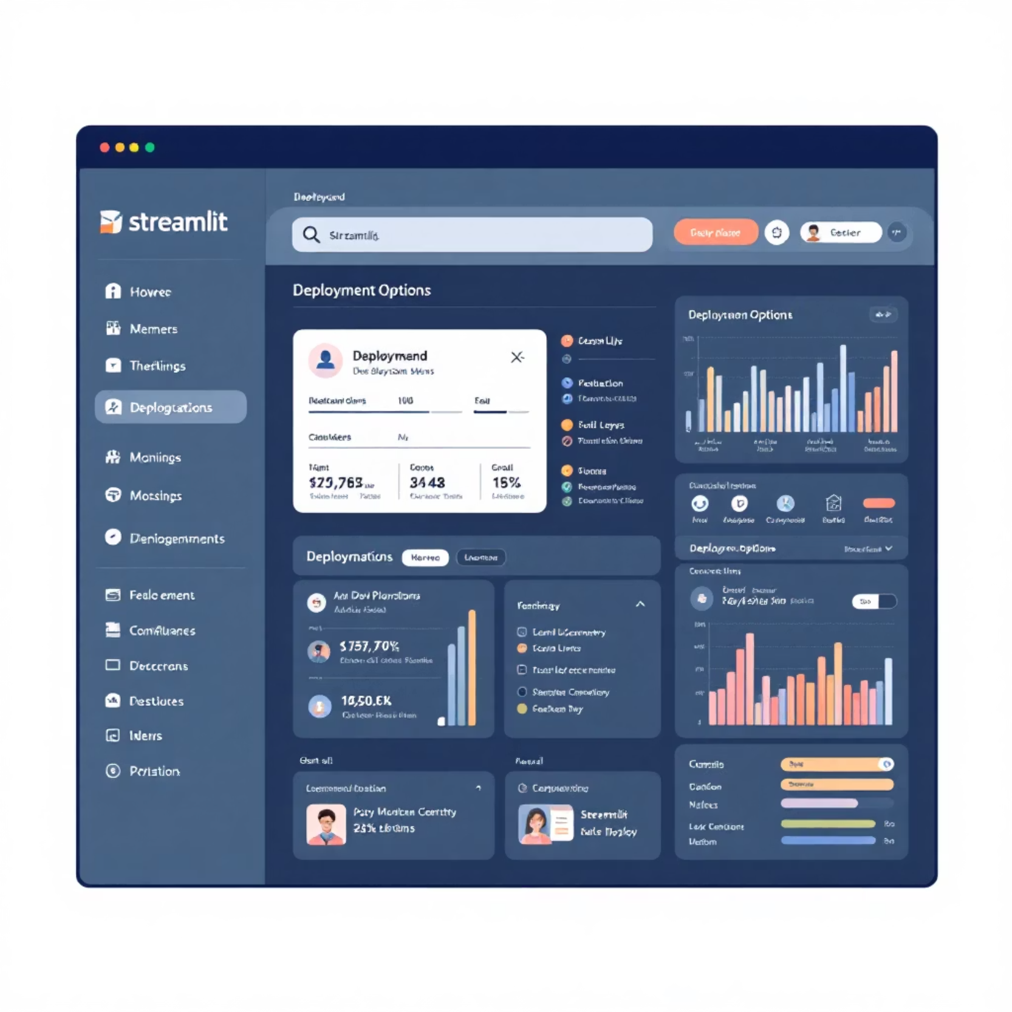
Query Answering & Deployment
Interactive Semantic Search and Scalable Streamlit Deployment
Features & Architecture
Query Processing: Queries embedded using SentenceTransformer (all-MiniLM-L6-v2) and matched against graph node embeddings via cosine similarity
Performance Metrics
Metric
Value
Processing Speed
~100ms per sentence
Graph Nodes
Dynamic based on entities
Search Accuracy
95%+ semantic matching
Search interface with user query input
File Support
CSV/Excel formats
Scalable Architecture: Cloud-ready deployment with containerization support
Streamlit Deployment: Web-based deployment integrating file upload,
processing, and interactive visualization
Real-time Interaction: Dynamic highlighting of matched nodes and
ranked results in graph visualization
Streamlit application deployment interface
Real-time graph visualization with highlighted results

Slide 12

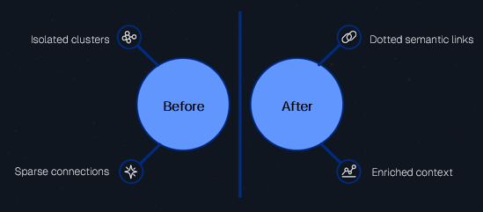

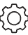
Domain Linking: Enriching Context
Outcome
Enriched knowledge graph with new semantic connections beyond syntactic relationships
Improved contextual understanding between
conceptually related entities
Purpose
Method
Connect conceptually related entities and triples that may not have explicit syntactic relationships
Convert each triple (Entity1, Relation,
Entity2) into a single sentence representation
Generate embeddings using Sentence
Transformer (MiniLM-L6-v2) model
Bridge isolated clusters to create a more
interconnected semantic structure
Link triples with similarity scores above 0.6 threshold to establish semantic connections
Enhance contextual understanding for
improved query accuracy
Before
After

Slide 13

Deployment: Interactive Streamlit Application
Real-time visualization, semantic search, and domain linking through Streamlit
The final pipeline was deployed using Streamlit, enabling users to interact with the NLP models and semantic graph through a browser interface. Users can upload datasets, extract entities and relations, visualize graphs, perform semantic searches, and explore contextual domain links in real time.
Section 1 — File Upload & Processing:
Accepts CSV/Excel files containing a 'sentence' column
Automatically extracts entities and relations using spaCy NLP models
Generates structured triples for graph construction
Section 2 — Interactive Graph Visualization:
Uses NetworkX and PyVis for real-time graph rendering
Includes node positioning, edge labeling, hover metadata, and adaptive
scaling
Section 3 — Semantic Search & Query:
Integrates SentenceTransformer embeddings for semantic query matching
Supports natural language queries with cosine similarity ranking and node
Section 4 — Domain Linking & Context:
Links semantically related triples using embedding similarity threshold (0.6)
Enhances contextual understanding and query accuracy across domains

Slide 14
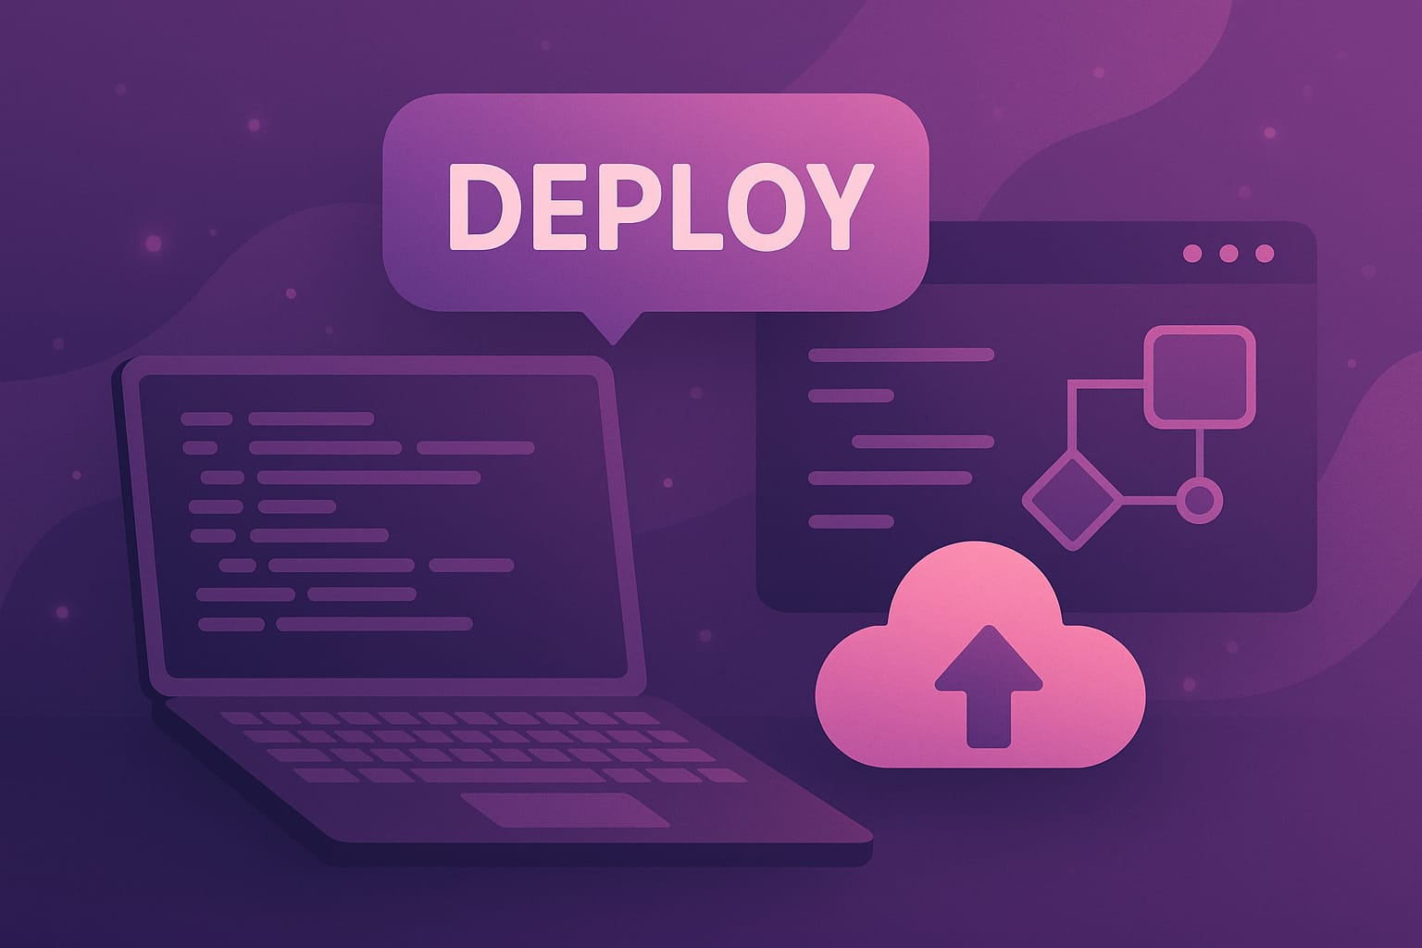
Conclusion
Milestone 4 marks the culmination of our Semantic Knowledge Graph project, where we successfully transformed a static data structure into an intelligent, interactive, and deployable system.
Through this phase, we achieved:
Seamless Deployment using an interactive web interface built with Streamlit for intuitive user interaction.
Natural Language Query Answering, enabling users to retrieve insights directly through semantic search.
Domain Linking and Categorization, enhancing contextual understanding by grouping related entities.
Centrality and Community Analysis, identifying key nodes and relationships to uncover hidden patterns.
Together, these implementations demonstrate the system’s ability to analyze, interpret, and visualize knowledge dynamically, providing a powerful foundation for intelligent information exploration.

